Slide 1
CREDIT CARD CHURN PREDICTOR
Diana Madonko
Franz Kiel
Jason Sutton
Swobabika Jena
Thomas Maina
Will Bobzin

Slide 2
The day you sign a client is the day you start losing them.
-Don Draper – Mad Men

Slide 3
Roadmap
Topic selection & dataset acquisition
Machine learning model development
Front-end to back-end connection.
1
3
5
2
4
6
Exploratory analysis & Data Wrangling
Front-end development
Product deployment and testing

Slide 4
Topic Selection & Dataset Acquisition
1
Challenges and opportunities with datasets

Slide 5
Why bank churning prediction?
Real
We wanted to develop models with actual business applications.
Applicable
If applied to the right data, the models can work with many different industries besides banks. From health insurance to fitness centres and streaming services.
Reliable
Bank data is expected to be of high quality, particularly for demographic information. Document proof is usually required.

Slide 6
Expected Final Product
A tool that can predict likelihood of a customer leaving the bank:
HTML front end to capture client data
Machine learning model operating in the background
Reliable prediction for any given customer
This tool could be applied in different fields if applied to relevant datasets.

Slide 7
Exploration & Wrangling
2
Diving into the Data

Slide 8
Exploration Outcomes– Basic Information
23 columns
Mostly demographic information
Bank-related data – type of credit card, transactions made, etc.
10127 Rows
No Null values
‘CLIENTNUM’ as Index
Many “Unknown” values

Slide 9
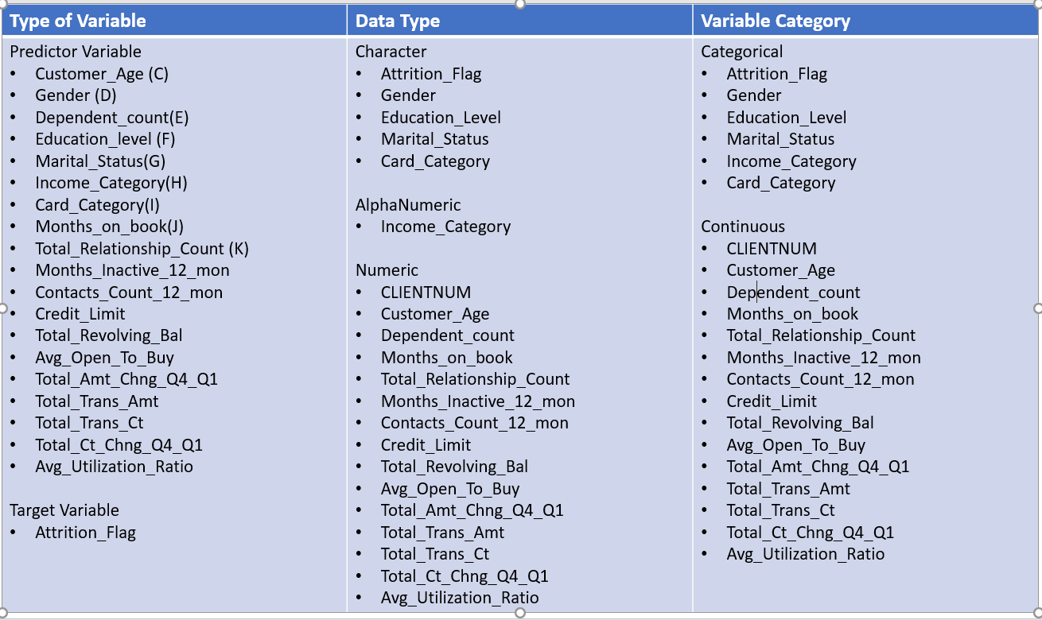
Exploration Outcomes– Variable Identification
Identified type of data and category of each variable
Serves as reference at exploration and execution stages

Slide 10
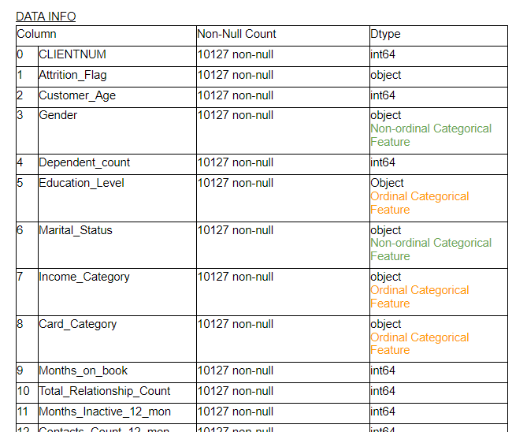
Exploration Outcomes– Univariate Analysis
Basic table with type of data for each column
Serves as reference at exploration and execution stages

Slide 11
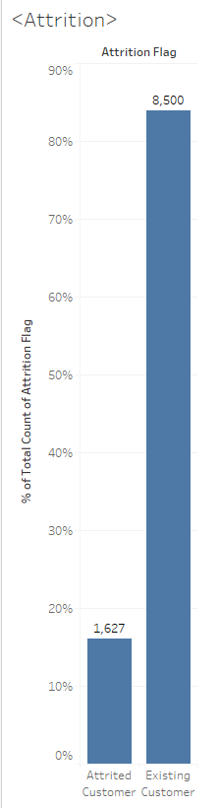
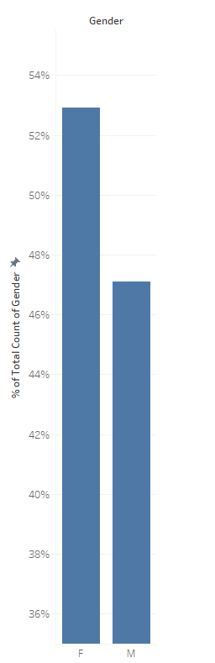
Exploration Outcomes– Univariate Analysis
16% of customers in the data set have closed their accounts.
Gender is slightly biased towards Males, but not significantly.

Slide 12
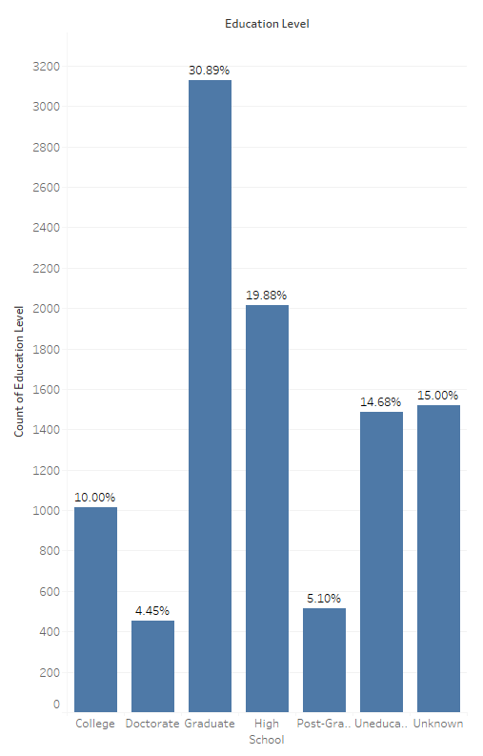
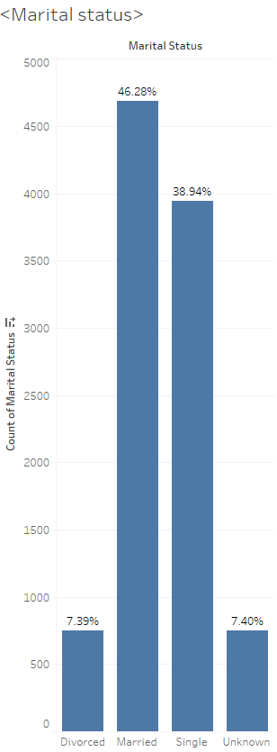
Exploration Outcomes– Univariate Analysis
Education level data is not solid, 15% stated “Unknown”
Similar issue with Marital Status, with 7.4% “Unknown”.
Notes:
Education level data is not solid, 15% stated “Unknown”
Similar issue with Marital Status, with 7.4% “Unknown”.

Slide 13
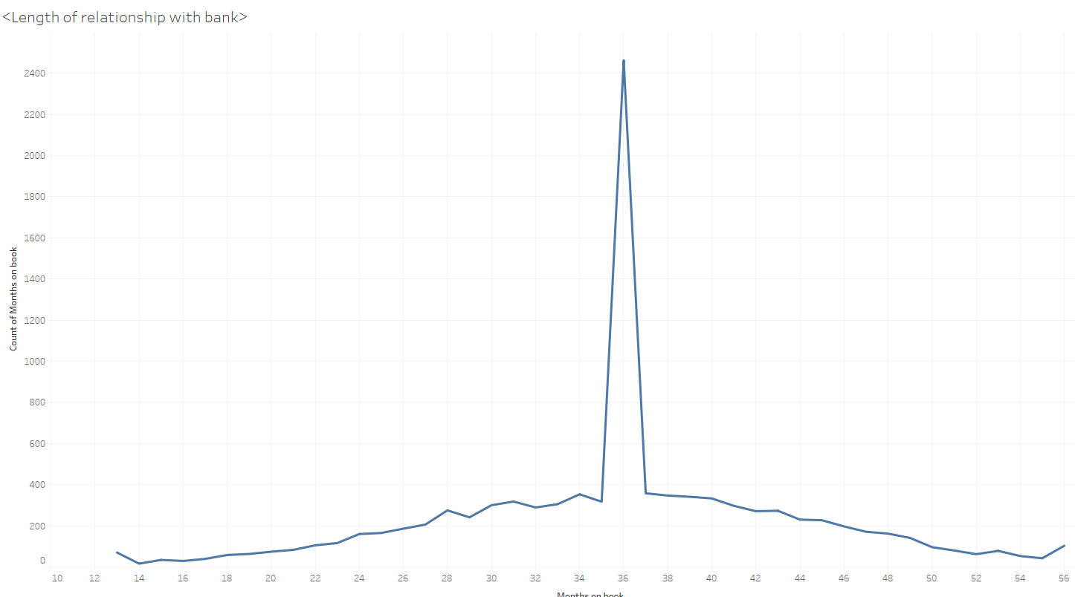
Exploration Outcomes– Univariate Analysis
Notes:
Education level data is not solid, 15% stated “Unknown”
Similar issue with Marital Status, with 7.4% “Unknown”.
Clear bias detected in Length of Relationship – 24.3% of customers have been so for exactly 36 months.

Slide 14
Exploration Outcomes – Univariate Analysis
Clear bias detected in Length of Relationship – 24.3% of customers have been so for exactly 36 months.

Slide 15
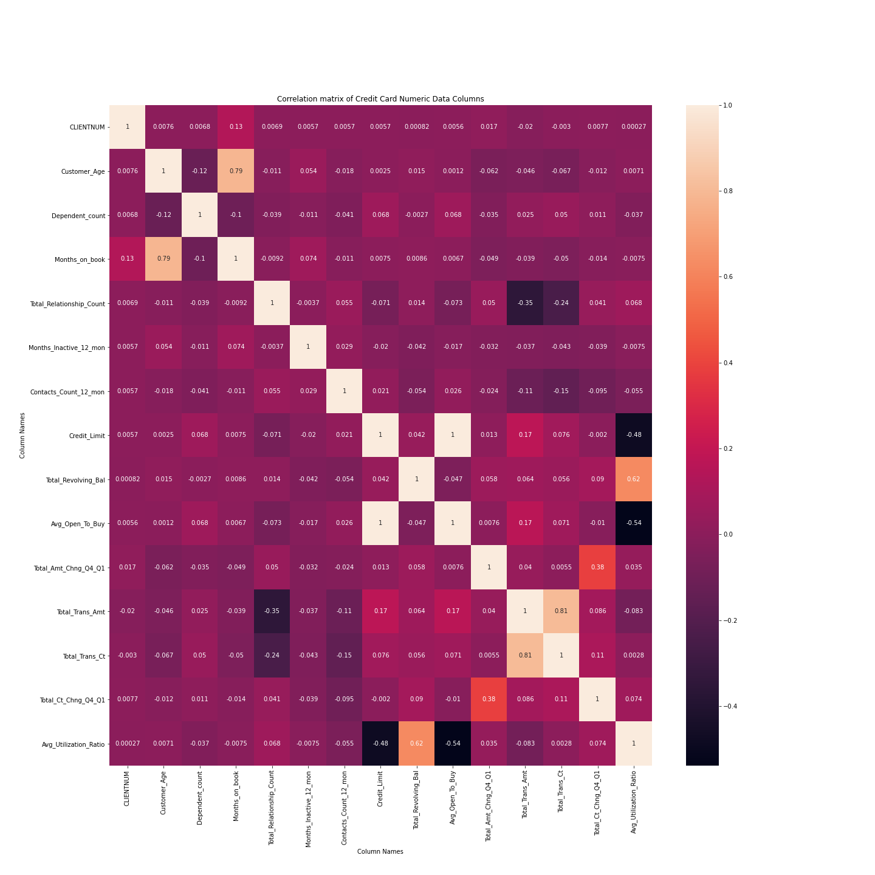
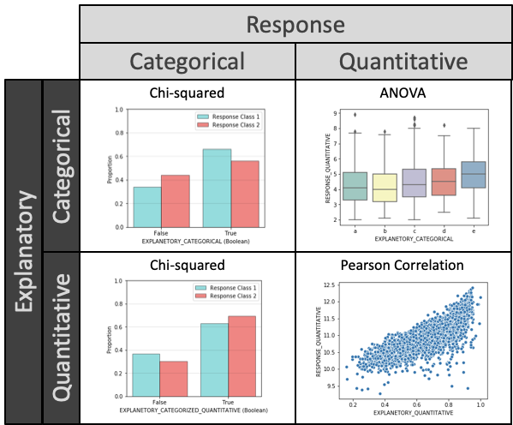
Exploration Outcomes– Multivariate Analysis
Notes:
Correlation Matrix
Applied to all continuous variables
Displays degree of correlation between variables
Analysis of explanatory and response variables

Slide 16
Exploration Outcomes– Multivariate Analysis
Statistical tests
Analysis of explanatory and response variables

Slide 17
Exploration Outcomes– Multivariate Analysis
Correlation Matrix
Applied to all continuous variables
Displays degree of correlation between variables

Slide 18
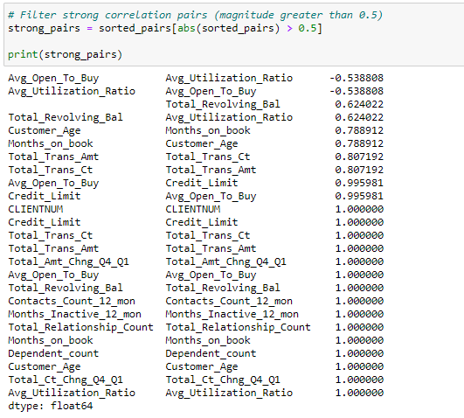
Exploration Outcomes– Multivariate Analysis
Through Pandas, sort pairs of columns based on correlation strength.
Some variables are predictably correlated (eg. “Credit Limit” and “Avg Open to Buy”)

Slide 19
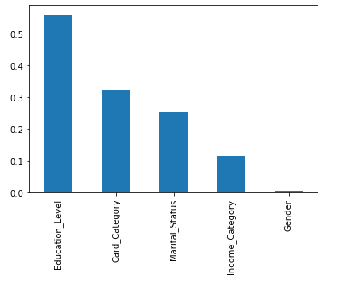
Exploration Outcomes– Multivariate Analysis
Chi-Square Tests
Five category predictors and one category response “Attrition_Flag”
All parameters show p-value>0.05. Variables are independent of the response parameter and can’t be considered for model training.

Slide 20
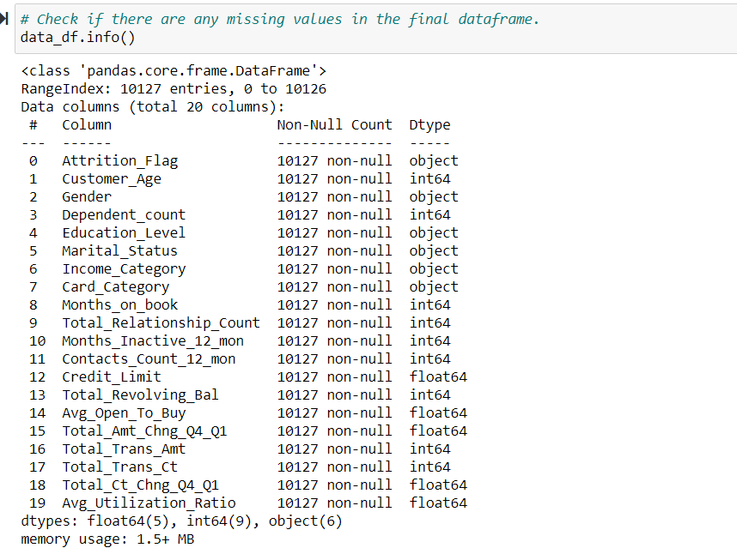
Exploration Outcomes– Missing Value Treatment
No missing values in the dataset

Slide 21
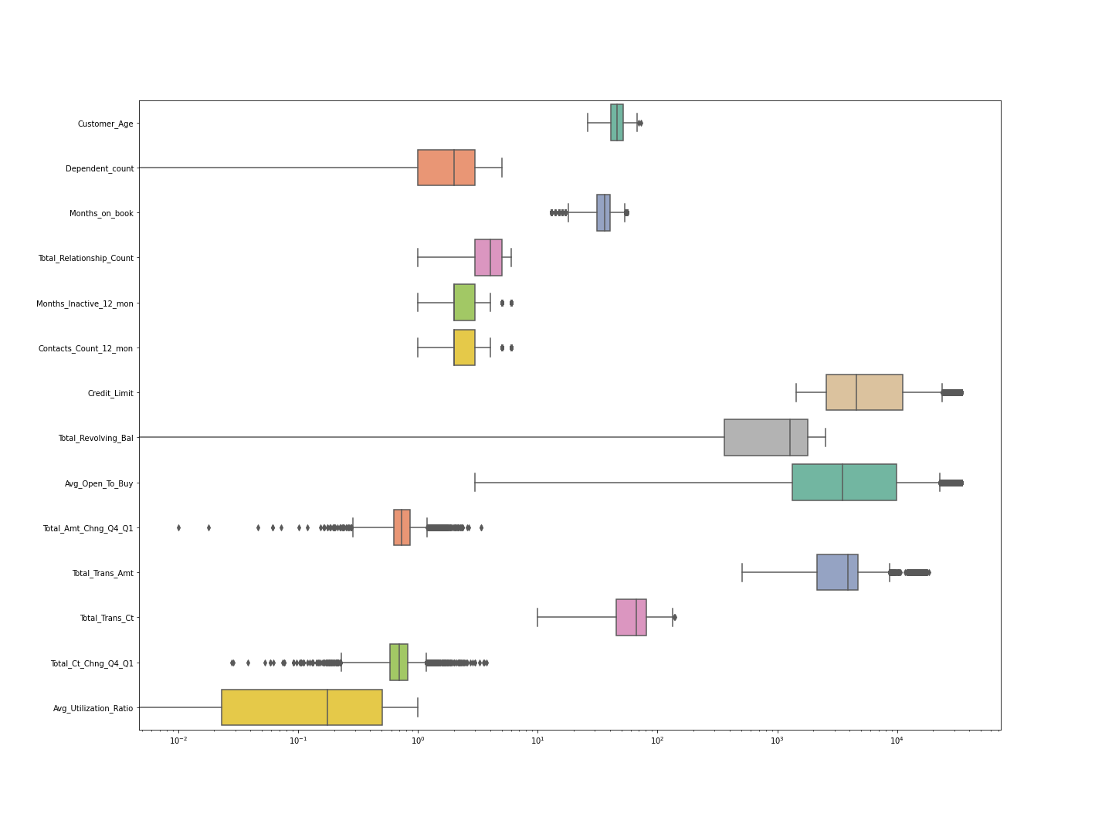
Exploration Outcomes– Outlier Treatment
Many variables show outliers
These outliers seem naturally occurring

Slide 22
Exploration Outcomes– Conclusions
‘Credit_Limit’ and ‘Avg_Open_To_buy’ columns have a perfect positive linear correlation of almost 1, hence we decided to retain ‘Avg_Open_To_buy’ column only
2. ‘Total_Trans_amt’ and ‘Total_Trans_ct’ have a strong positive linear correlation of 0.81 . The way we dealt with it was to perform ‘Total_Trans_amt’/‘Total_Trans_ct’ to get a new column 'Amt_per_Trans'.

Slide 23
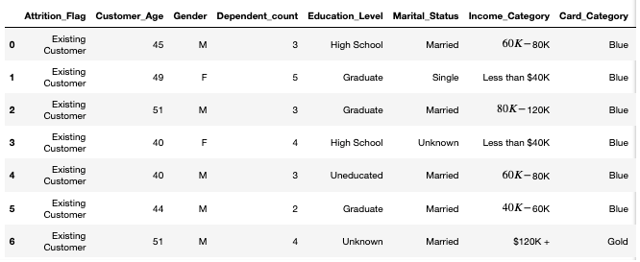
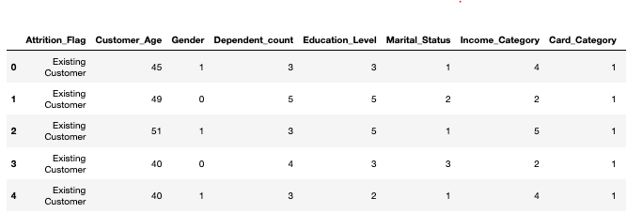
Exploration Outcomes– Pre-processing
Ordinal and non-ordinal categorical features
Split data into X (features) and Y (classes)
Split data into Train and Test data
Label Encoding Y classes One-hot encoding
Before After
Notes:
Ordinal Categorical Features
one class is higher than another – created by mapping the order
Education_Level
Income_Category
Column - Card_Category
Non-ordinal Categorical Features
No specific order of class – Scikit Learn LabelEncoder
Gender
Marital_Status
Also scaled using MinMaxScaler – but only for continuous data – Wanted to leave the categorical features are their integers – which had its own challenges

Slide 24
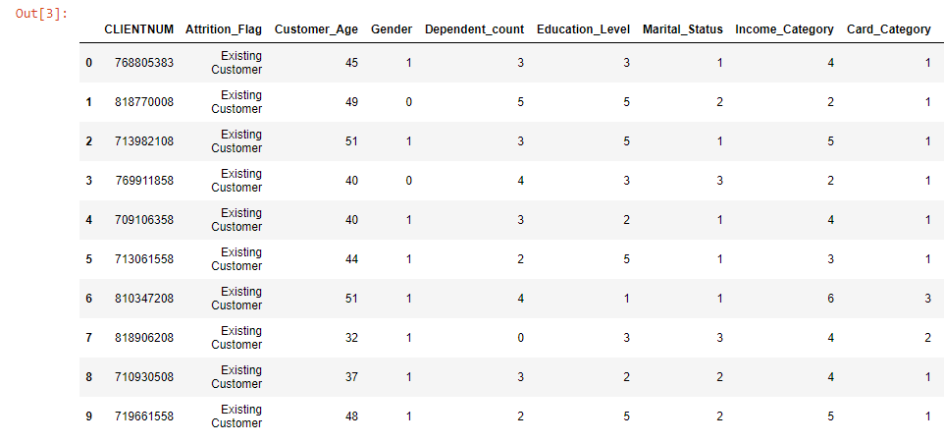
Final Dataset
21 Columns
Fully encoded – using integers to represent categorical features (eg. ranking by income bracket)

Slide 25
Machine Learning Model Development
3
Applying and comparing models

Slide 26
Machine Learning Model Development - Modelling Approach
Models
Decision Tree – Score 0.937
Random Forest – Score 0.962
Logistic Regression – Score 0.88
K Nearest Neighbour – Score 0.9
Notes:
Trialling 4 models, you can see that there was three vying for top place, but the clear winner is the Random Forest.
This result was achieved without completing a Grid Search – I found that running a Grid Search could take quite a bit of time for the computer to process. If time was permitting, it would have interesting to see if it would have resulted in a better score.
We were pretty happy with 96% accuracy.

Slide 27
Modelling Approach– Random Forest
Powerful classification model
92.48% Actual Accuracy
27 customers incorrectly predicted out of 359
Most representative code or chart snapshot?

Slide 28
Modelling Approach– Logistic Regression
Resource efficient classification model
88.7% Test model Accuracy
90.16% Training Model accuracy
Comments?
Most representative code or chart snapshot?

Slide 29
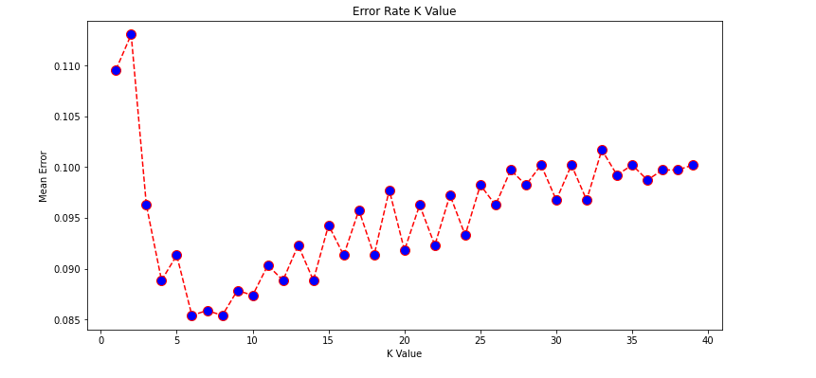
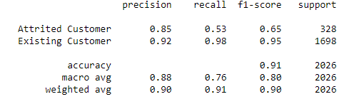
Modelling Approach– K Nearest Neighbour
Straightforward classification algorithm
0.91 F1 Score
How to express the accuracy?
Most representative code or chart snapshot?

Slide 30
Modelling Approach - Conclusion
RANDOM FOREST:
92.18% Actual Accuracy
28 customers incorrectly predicted out of 358
This model allows us to confidently make predictions.
Notes:
I did a comparison dataframe with the ACTUAL success rate slightly dipping but we were still happy with this accuracy

Slide 31
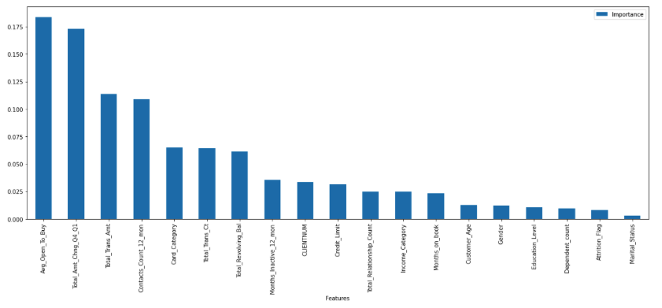
Modelling Approach – Feature Importance
Further exploration could occur to determine if some features were unnecessary
Open_To_Buy
Total_Amt_Chng_Q4_Q1
Trans_Amt
Contacts_Count_12_mon
Card_Category
Total_Trans_Ct’),
Total_Revolving_Bal'
Notes:
Generating the feature importance
It shows that the data of most relevance is around the amount of money customers have available and the amount of transaction carried out.
The customer demographics are all at the lower end of importance.
More analyses could be done around whether those with less credit available are the ones who are the ultimate churn risk.
And whether dropping the demographics data would impact the accuracy.

Slide 32
Front-End Development
4
Making models accesible to users

Slide 33
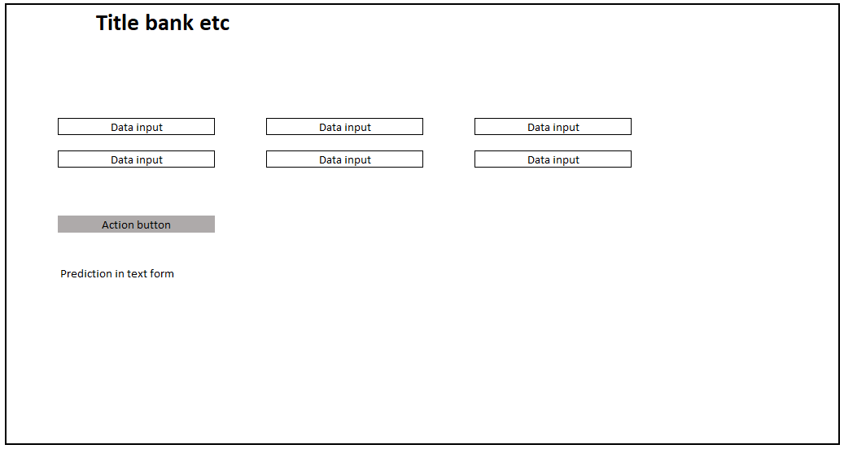
Front-End Development – Early Draft

Slide 34
Front-End Development - Tools
Tools
HTML – Web Interface
CSS - Styling
JavaScript & D3 – user input collection and back- end parsing
CSV file support for mass modelling

Slide 35
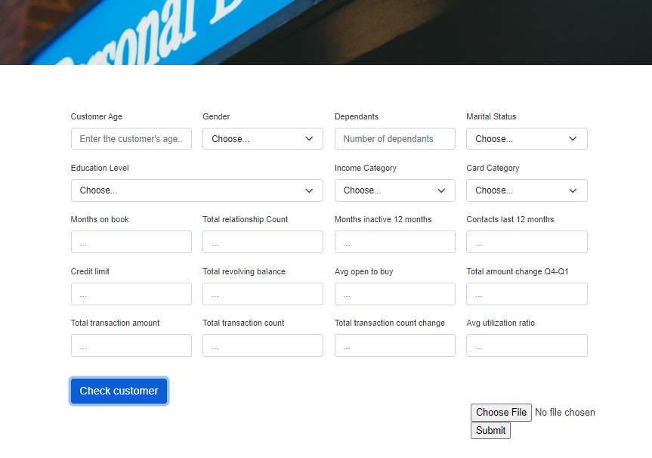
Front-End Development – User Interface
Drop downs for ease of use (categorical data)
File upload support (CSV)
Button to trigger check
Simple, clean visual identity

Slide 36
Front-End Development – additional content?
Here you have:
Anything else we want to mention?
And some text

Slide 37
Front-End to Back-End Connection
5
Bringing the pieces together

Slide 38
Front-End to Back-End Connection- Tools
Tools
Flask – two routes
User individual selection
@app.route(“/individual”,methods=[“POST”] def individual():
CSV file
@app.route(“/bulk”, methods=[“POST”]) def bulk():(
Pre-processing
Machine Learning – imported model
Return results to JavaScript to visualise on screen
Notes:
Two routes
Individual – input from the web form
Bulk – input from the csv
Input had to go through the full process of:
Encoding – bulk only / for individual prediction categorical input was captured as numerical input from the web from
Scaling – imported model
Machine Learning – imported model
Returned the outcome to javascript
The struggle was that returning data to javascript was a issue - process for individual didn’t work for bulk so that took a lot of problem solving.

Slide 39
Front-End to Back-End Connection– additional content?
Here you have:
Anything else we want to mention?
And some text or screenshot?

Slide 40
Product deployment and testing
6
Making the final product accesible

Slide 41
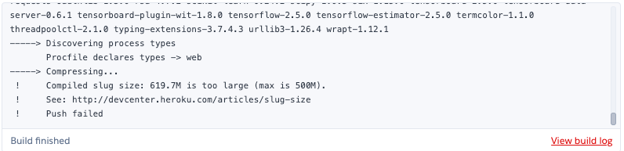
Product deployment and testing- Heroku
Challenges
Slug ignore file
File size limits

Slide 42
Ideas and Improvements
Things that could have been done differently:
Implemented a database
Streamlined interface – less input fields
Delve deeper into dataset
This model allows us to confidently make predictions.

Slide 43
CONCLUSION
Our tool achieves the objectives, by collecting information for a given customer or customers and predicting whether they are at risk of cancelling their credit card.

